Slide 1
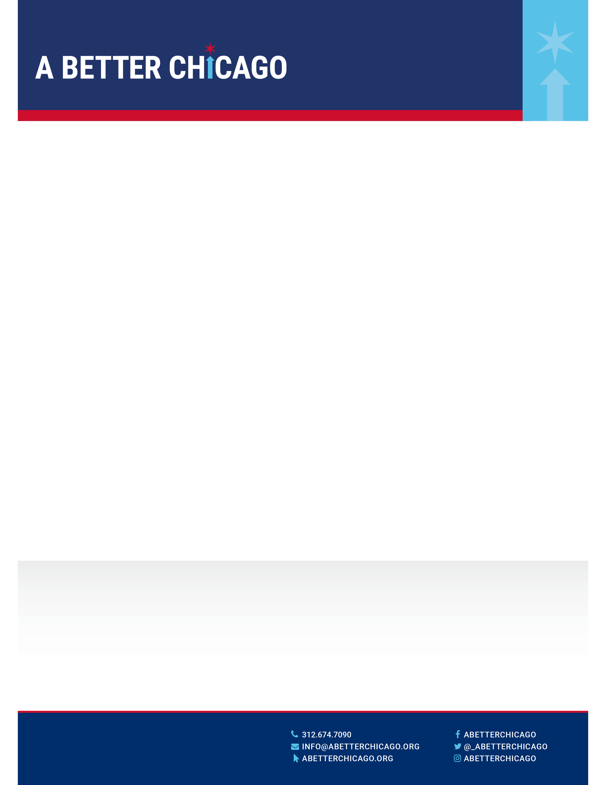
We are changing how Chicago fights poverty by investing in bold
Ideas that create opportunity for our youth.
OUR APPROACH
A Better Chicago invests in a group of nonprofits that is creating educational opportunity for our region’s low-income, at-risk population. All of the organizations we support have passed out rigorous due diligence prior to funding.
We construct our portfolio around three strategies: opening new schools, transforming existing schools, and scaling effective programs that provide targeted services to improve student achievement.
Through these strategies, we will increase the service capacity of Chicago’s best schools and programs by over 80,000 students by 2025.
Only 18% of Chicago Public Schools students are graduating from college.
We need to change that.
HOW WE’RE DIFFERENT
DILIGENCE
We do the homework for you and only in the most effective nonprofits
RESULTS
We carefully track our portfolio’s performance and share results
PARTNERSHIP
We invest financial and intellectual capital to help our nonprofits succeed
100% IMPACT
Every dollar donated is invested directly in Chicago’s best education nonprofits
OUR RESULTS
We’re building a movement for education opportunities.
35,000+
11
1,100+
$20M+
Lives impacted by schools and programs in our portfolio
Grantees selected through rigorous
due diligence
Donors engaged in
impacting education
in Chicago
Value of grants and
Support delivered to
portfolio

Slide 2
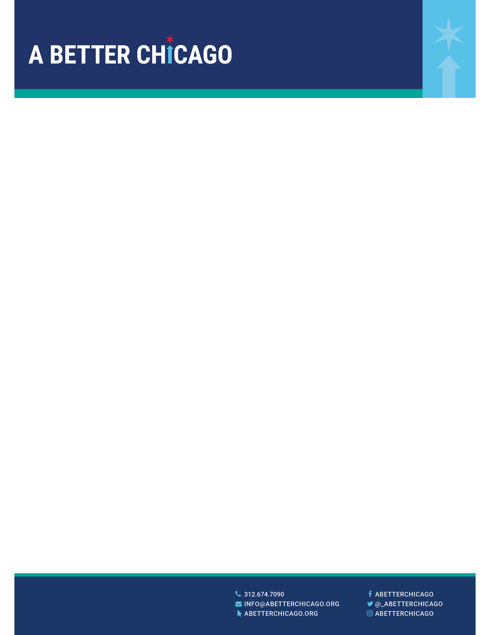


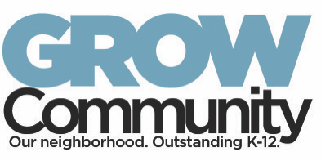



Our Portfolio
A Better Chicago invests in a group of nonprofits that is creating educational opportunity for our region’s low-income, at-risk population. All of the organizations we support have passed our rigorous due diligence prior to funding. While our grantees vary in terms of size, location and tenure, they share several important traits, including a results-driven program model, strong leadership, solid financials and a vision for growth.
GROWTH FUND
Significant investments to grow successful organizations with
strong track records
VENTURE FUND
Seed investments in promising, early stage models with
strong leaders

